Slide 1
Destined Duo
Notes:
We are team __ and we created Destined Duo

Slide 2

Hello! We are Team BARK
Brianna
Aneesh
Ruchika
Kyra
Notes:
Hello everyone, we are team bark comprised of Brianna Aneesh Ruchika and Kyra.

Slide 3
AGENDA
Description
Value
Goal
Differentiation
Architecture
Database
Demo
Q & A
Notes:
Today we will be discussing our project description, its value, and the goal we are trying to accomplish, how our app is different from other apps in the market, our site architecture, an overview of the database and its connections and a quick demo followed by a q&a session

Slide 4
What it does?
Allows users to find other users who share the same interests
Explore all shared users with shared interests
Search for users based on interest
Provides general and contact information to discuss topics or make plans
Notes:
The core functionality of Destined Duo is to allow users to locate other users with the same shared interests. Upon registering, users are prompted to provide a list of interests. Based on these interests, the user is able to use the “Explore” page to locate all user that have a matching shared interest. The user is also able to search the website based on an interest in order to limit search results. Because it operates as a matching site, the user provides general information and contact information such as an email and social media handles at their disclosure in order to reach out and further discuss a topic or make plans based on the shared interest.

Slide 5
Who it serves?
Anyone!
People looking to continue activities or hobbies with a friend!
Meet up with people who want to do the same hobbies, sports, games, etc. as you
Notes:
Destined Duo serves anyone and everyone. More specifically this application targets people who are looking to start or continue activities or hobbies with a friend. We see destined duo especially serving people who are making a transition in their life such as going to college, moving to a new area, or starting a new job. By using destined duo people who are looking for friends or ways to get back into their interests can find people with shared interest to hopefully get back to the activities they enjoy.

Slide 6
What’s its goal?
FIND USERS WITH SHARED INTERESTS
Support people intimidated to participate in their interest alone
Interest requires more than one participant
Find other similar interest
Learn more about your desired interest
Notes:
As you may have guessed, the main goal of destined duo is to find someone who shares the same interest as you. Beyond this, the goal of our application is to help connect people who may be intimidated to participate in their hobbies alone. Our app also targets those who may require more than one participant for their interest. Destined Duo can even be used to find people who might be able to expose you to more related activities or help you learn more about your interests

Slide 7
Facebook groups
Public, closed, or secret gathering space
Join 6,000 groups
Access and add to feed
Differentiation
Focus on gathering space
Feed
Required to search for groups with interest
Notes:
In terms of other players in a similar market as Destined Duo, facebook groups is our biggest competitor. Facebook groups are public, closed or secret spaces within the social media network allowing users of Facebook users to gather virtually. Facebook users can either join or request to join up to 6,000 groups. Once a member of a group, the user will be able to see and add to the feed corresponding to that group.
Unlike facebook, Destined Duo focuses on creating a relationship based on a shared interest rather than a gathering space. Destined Duo has limited profiles and no feed feature because users of the website have the goal of finding a person with a shared interest in order to make plans or discuss this topic. Most importantly, Facebook groups requires the user to search for an interest group that best fits their needs. The intention of destined duo is to reduce the barrier of an interest by recommending people solely based on their interests.

Slide 8
Meetup
Advertise group
Event based connections
Differentiation
Focus on events
Advertisement based rather than interest based searching
Notes:
Meetup is an web application allowing users to promote events in order to locate users. Users are prompted to create an advertisement for the group that other users can then view and join. The main difference between Destined Duo and meetup is that meetup focuses on creating events while Destined Duo focuses on forming relationships. Users of Meetup can attend events of other listed groups; however, Destined Duo gives the user the freedom to form any relationship with users such as discussion or joint participation in an interest.

Slide 9
Personal Social Media
Instagram
TikTok
Twitter
Snapchat
Differentiation
Popularity focused
Recommend based off user’s friends
No further discussion expected
Notes:
Other platforms that can compete with Destined Duo are personal social media platforms such as Instagram, TikTok, Twitter, and snapchat. These social media accounts allow for users to either follow or friend users. By following/friending, the user will be able to see the content in the feed. Relationships are formed virtually though likes, follows, saves and other user reactions.
Unlike Destined Duo, recommendations are mainly given through showing popular accounts of friend’s of the users or by recommending friend’s of friends. Also, there is no guarantee that upon following a user that you will have similar interests. While users may search for account relevant to their interests, there is not an expectation to connect with the user in hope to start doing activities together. Destined Duo provides social media account information so that users can continue conversations and learn more about the user but social media accounts do not support an alternative to destined duo.

Slide 10
Features
Homepage
1
Register
2
3
Login
Profile Page
5
4
Explore Page
Notes:
Our features include a homepage which we created to allow users to signup page to allow users to register as a new user, a login page. The profile page is each user’s personal page that contains an editable profile! Users can add a profile picture, bio, contact info, social media links, and add any new interests to their page. The explore page is where users can find other people with similar interests to theirs, they simply search for any interest and the result will be matches with other people. From that point users can click on them and their profile information will be displayed including links to social media if they wish to reach out and start a conversation with another user, who might also be looking for someone to start a new hobby with

Slide 11
Data Management
user_interests
profile_media
users
profile_information
Notes:
We store the data for our site within a mysql database using phpmyadmin. Our data is arranged with four tables that are connected with foreign key. Our users table stores the general information for each user, including, (username, password, fname, lname, age, and email). The user_interest stores each interest of every user with an (id, username(which is a foreign key to users table), and the interest. Therefore each interest is stored in a separate row and we limit the amount of interests per user to 5. The profile_information table includes the username(foreign key), description(which is a user’s bio) and the path to their profile picture. Lastly, the profile_media table contains an id, username, social media platform(Twitter, instagram, etc) and the link to their social media

Slide 12
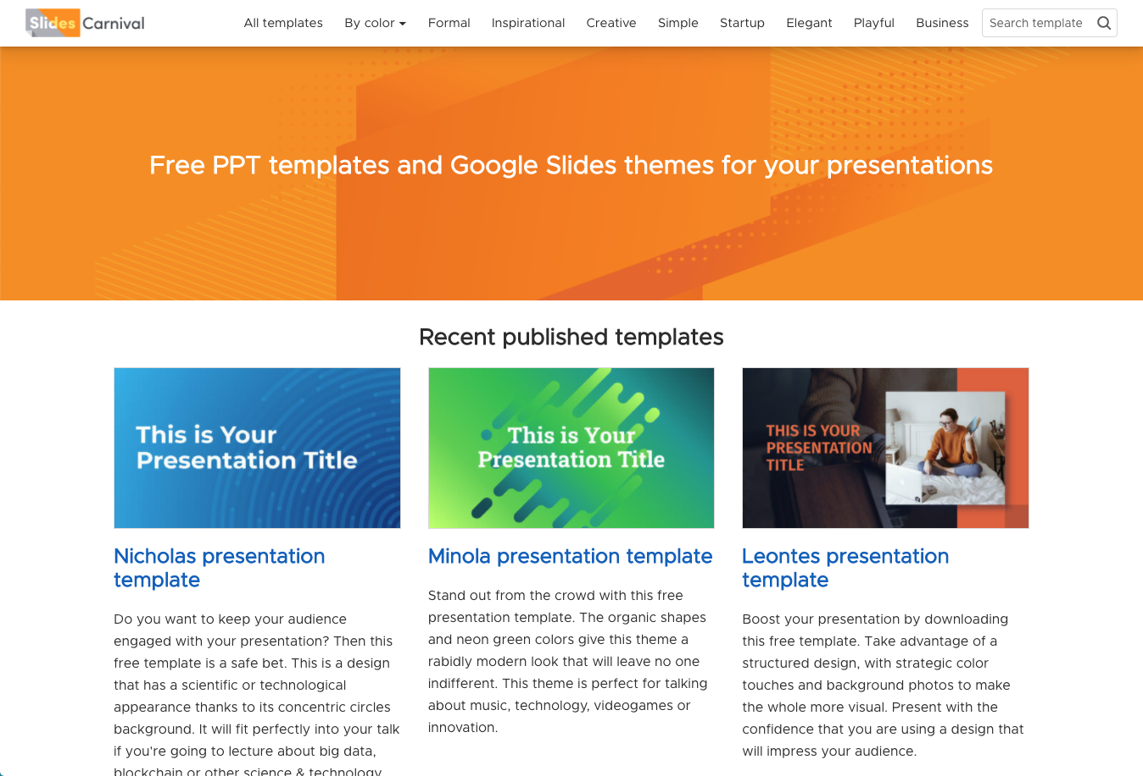
DEMO

Slide 13
Future Plans
Recommended Friends
Have recommended friends displayed before search
Notes:
One feature we are planning to implement by Friday is to have recommended friends displayed on the explore page. We wanted to take the users interests and display other users with similar ones, so they could find people without having to search.

Slide 14
Future Plans
Locations
Including user locations and sorting by city to find people close to you
Google Sign-In API
Allow users to sign in with their gmail account
Resources
For each interest have list of resources of nearby activities
Notes:
Outside the scope of this class, we have discussed future iterations of this project and what feature could be added. This included adding a user’s location(city) and then we could sort the matches from the explore page to be displayed by the other user’s closest to you. Another idea is to integrate google’s sign-in by using their API to have more secure and easier sign in and signup processes. We also discussed having a resources section. This would be helpful as a directory of sorts, that would be able to obtain a list of nearby activities that match user’s interests.

Slide 15
THANKS!
Any questions?

